Slide 1

STUDY OF PARAMETERS OF ZIRCALOY METAL FORMING PROCESSES
Under the guidance of
Shri. M. CHAITANYA REDDY
Nuclear Fuel Complex Department of Atomic Energy Government of India
B. Sri Vardhan
198034
Material Science and Engineering

Slide 2
Index
Table of contents | Slide No.
Overview of NFC | 3
Nuclear Power Plants in India | 4
Nuclear Reactor | 5-6
Plasma arc melting Principle Parameters | 7
Manufacturing of sheets | 8
Fuel bundle products Making of zircaloy products from sheets, bars and rods | 9-18
Control rods
Conclusion | 19-20

Slide 3
Production Facilities
Zirconium Oxide Plant
Zirconium Sponge Plant
Melt Shop Plant
Extrusion and Piercing Plant
Zircaloy Fabrication Plant
Uranium Oxide Plant
Ceramic Fuel Fabrication Plant
BWR Fuel Fabrication Plant.
Fast Reactor Facility Plant
Special Materials Plant
Stainless Steel Tube plant

Slide 4
LIST OF NUCLEAR POWER PLANTS IN INDIA
Power Plant | Location | Operator | Type | Capacity (Mwe)
Kaiga | Karnataka | NPCIL | IPHWR-220× 4 | 880
Kakrapar | Gujarat | NPCIL | IPHWR-220× 2 IPHWR-700× 1 | 1140
Kudankulam | Tamil Nadu | NPCIL | VVER-1000× 1 | 2000
Kalpakkam | Tamil Nadu | NPCIL | IPHWR-220× 2 | 440
Narora | Uttar Pradesh | NPCIL | IPHWR-220× 2 | 440
Rajasthan | Rajasthan | NPCIL | CANDU IPHWR-220 | 1180
Tarapur | Maharashtra | NPCIL | BWR- 160 × 2 IPHWR-540× 2 | 1400
 | Total |  |  | 7480
Presently, India has 22 nuclear power reactors operating in 7 states, with an installed capacity of 6780 Mega Watt electric (MWe).
18 reactors are Pressurized Heavy Water Reactors (PHWRs) and 4 are Light Water Reactors (LWRs).

Slide 5
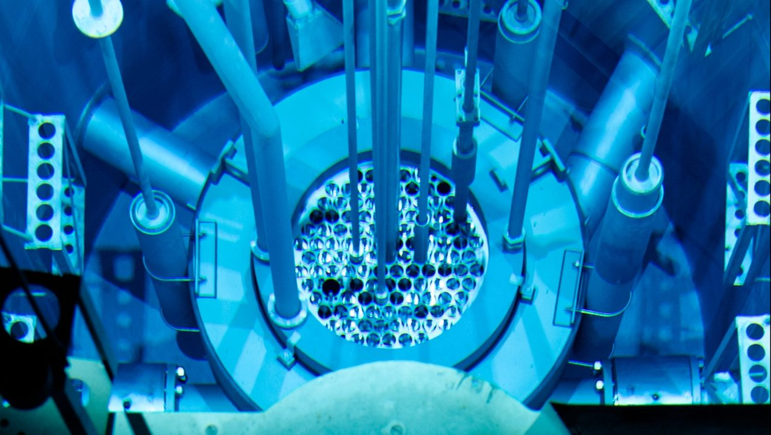
Nuclear Reactor
A nuclear reactor is a device used to initiate and control a fission nuclear chain reaction or nuclear fusion reactions.
Nuclear reactors are used at nuclear power plants for electricity generation and in nuclear marine propulsion. Heat from nuclear fission is passed to a working fluid (water or gas), which in turn runs through steam turbines.
It is classified into PHWR and BWR reactors.

Slide 6
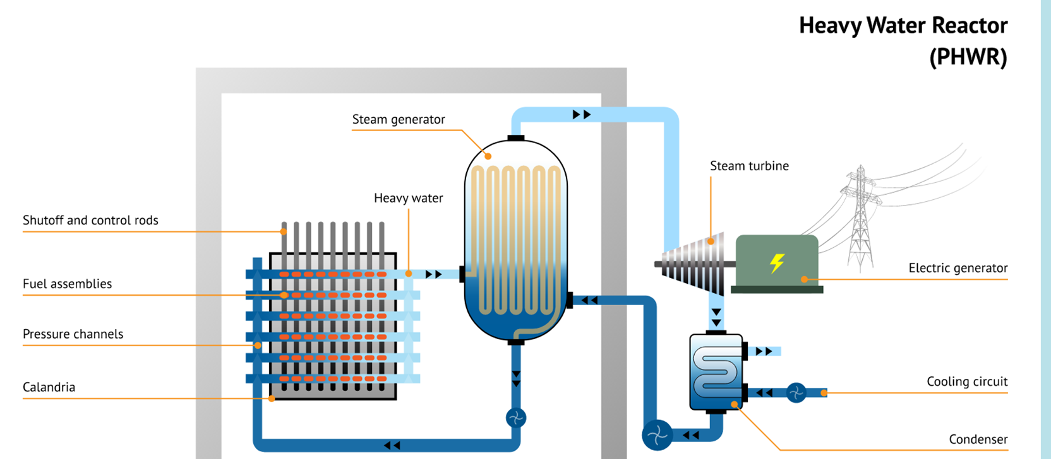
Pressurized heavy water reactor
A pressurized heavy-water reactor (PHWR) is a nuclear reactor that uses heavy water (deuterium oxide D2O) as its coolant and neutron moderator.

Slide 7
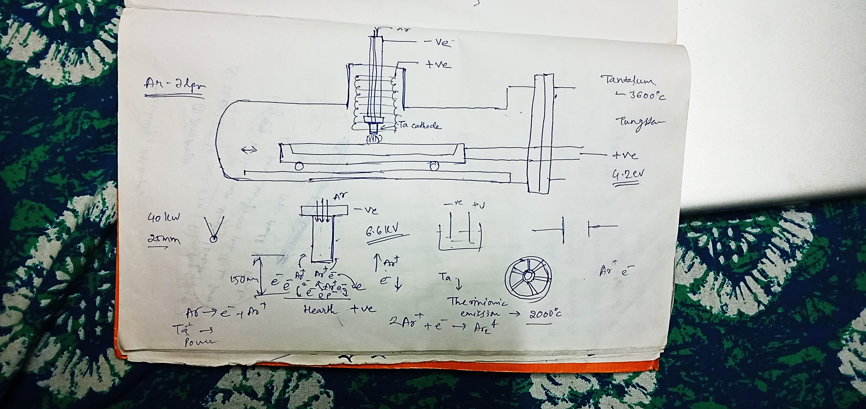
Plasma arc melting
For the melting and remelting of alloys like Zr4, which contain larger amounts of alloying elements with high vapor pressure that would evaporate under deep vacuum conditions, the plasma arc melting process (PAM) is chosen.

Slide 8
Working
The plasma arc melting unit is typically used for reprocessing the scrap if zirconium alloy produced in the nuclear industries.
The equipment comprises of a horizontal cylindrical steel chamber connected to high vacuum pumping system. The main chamber is water cooled copper hearth for loading massive scrap.
The cathode having annular gap around it injects the inert gas which can be helium or argon, at low pressure to act for plasma medium. The work is used as an anode.
In the beginning, a high voltage is applied to ionize the gas Positive ions raise the temperature of the cathode by bombarding with it and the temperature of the cathode is raised more than 2000k. And the cathode emits electrons and these from the cathode and plasma hit the work causing it to melt.

Slide 9
Principle
Using plasma arc melting, the metal is melted under inert gas atmosphere (usually Helium or Argon) in a pressure range between 400 – 1,200 mbar abs. The plasma arc torch column provides the heat source with maximum temperatures well above 15,000 K. Under these process conditions evaporation of alloying elements can be suppressed and complex alloy compositions can be produced.
Parameters
Plasma Gas: The gas commonly used is argon because of its excellent shielding properties which are useful in preventing the contamination.
Plasma Pressure: The plasma pressure is controlled by the plasma current and gas used. Higher plasma pressure is always recommended an in high pressure homogeneous mixing is done and the melting is done with higher efficiency.
Arc Current: With high arc current the melting power will decrease and the rate of melting will also be less, which is not economical and may lead to uneven mixing of materials.

Slide 10
ROLLING
The process of plastically deforming metal by passing it between rolls. In rolling, the metal is taken into rolls by friction and subsequently compressed to obtain the final shape.
Principle
Using plasma arc melting, the metal is melted under inert gas atmosphere (usually Helium or Argon) in a pressure range between 400 – 1,200 mbar abs. The plasma arc torch column provides the heat source with maximum temperatures well above 15,000 K. Under these process conditions evaporation of alloying elements can be suppressed and complex alloy compositions can be produced.

Slide 11
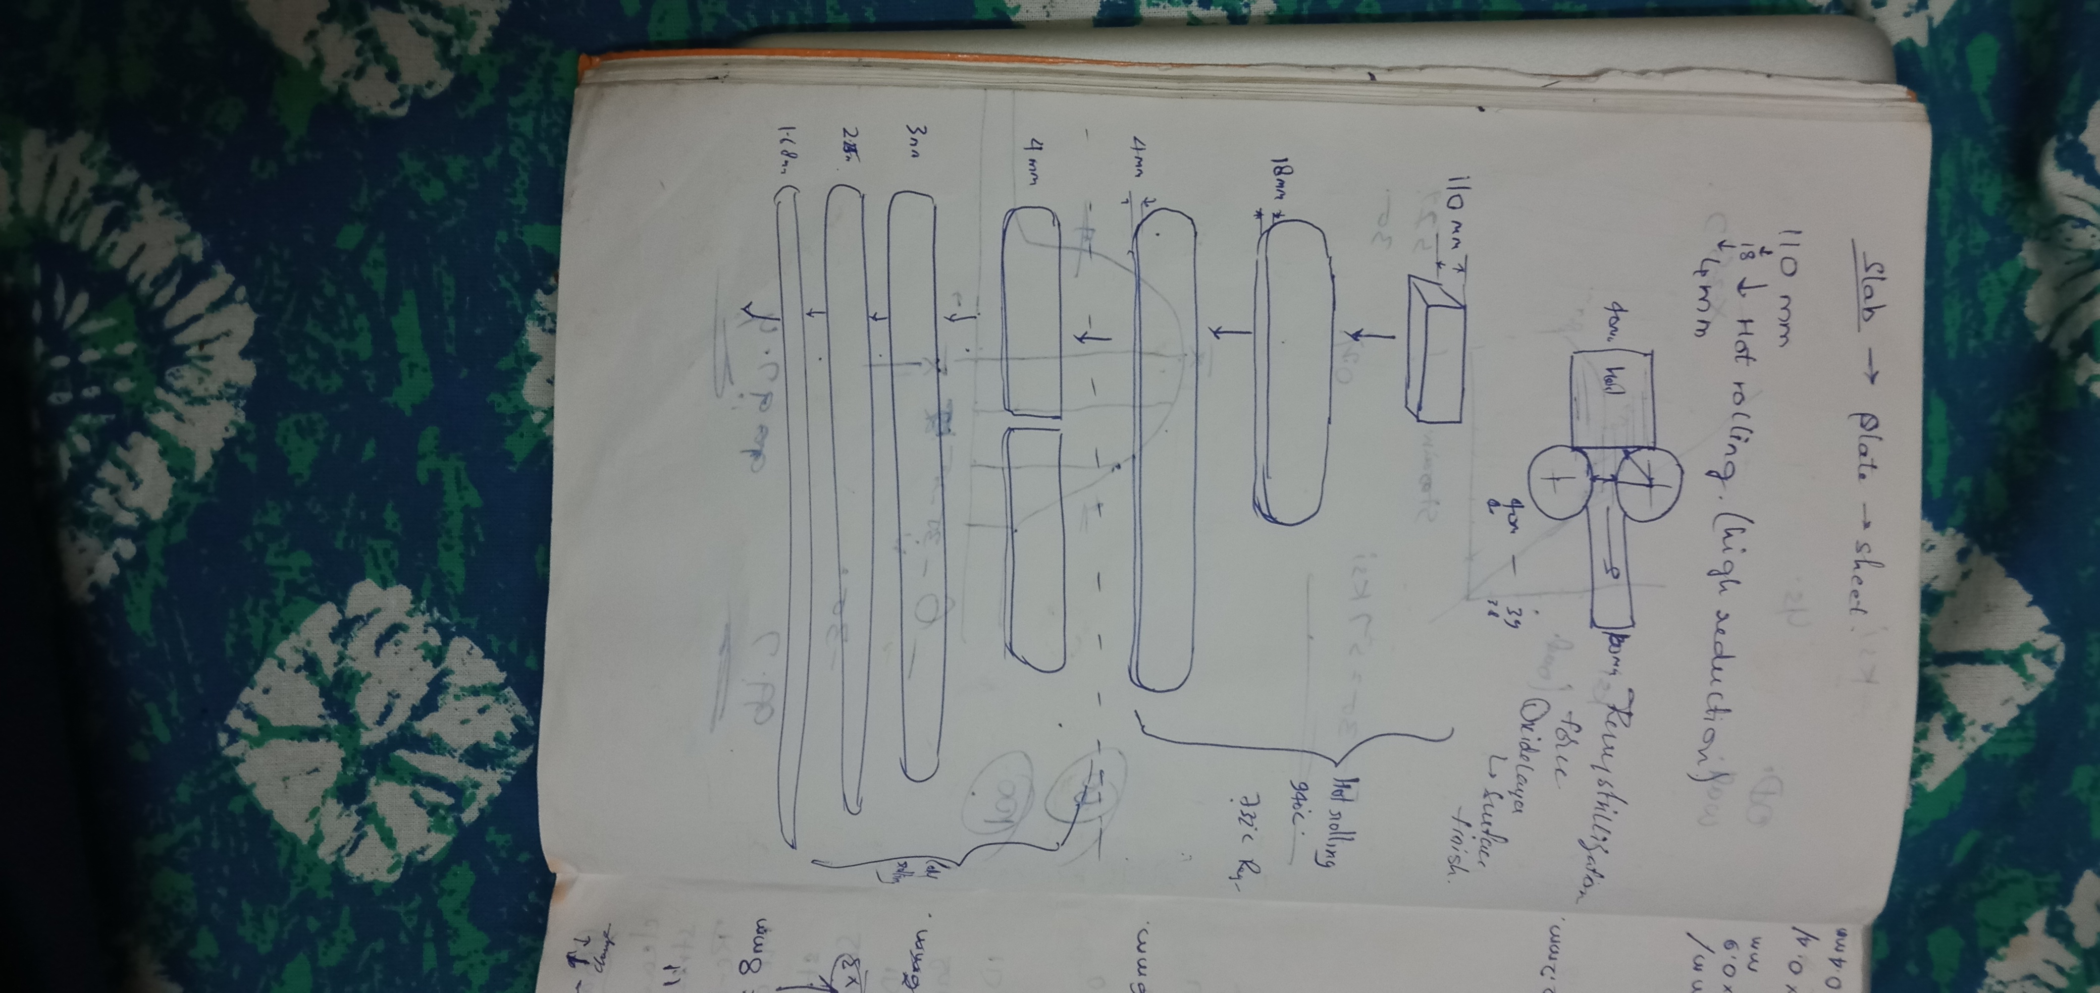

Slide 12
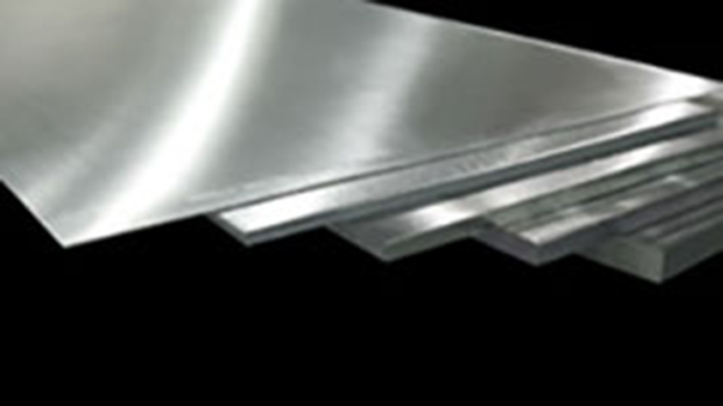
Manufacturing of sheets

Slide 13
Procedure
In the procedure of sheet production, the process is same until the final cleaned extruded blank as that of the bars. But in the extrusion of ingots for sheets we must use a die having rectangular shaped cavity, so the extrudate is also in the cuboidal form.
The extrudate is then cut into slabs of required dimensions. In order to remove the oxide layer from the slabs, these are subjected to plano milling machine for the oxide and scale layer removal.
The final slabs having a thickness of 110 mm are annealed at 940°C and soaked for approximately 2 hours.
Then the slabs are hot rolled using the two-high rolling process to plates of 18mm and the reduction is achieved in roughly around 7 passes, where each pass usually takes up to 2-3 minutes.
Again, the plates formed are hot rolled to sheets of thickness 4mm. Now the sheets are half cut to a required length, followed by grit blasting of sheets with particles of suitable grit size.

Slide 14
Next, the end cutting of the rolled sheets is done and then grinding is done with grinding papers of 80 grit specification and the grinding is done typically four passes on each side of the sheet.
The ground sheets are then sent for pickling in an alkali solution with required composition of chemicals to remove the grinding patterns on the surface and the left-over scales.
Annealing is then done at 760°C for four hours and the edges are trimmed with the help of edge trimming machine.
Then the sheets are pickled.
Now the sheets are cold rolled with the help of four-high rolling method 1.68m.
In between each reduction step of 3 to 2.25 mm and 2.25 to 1.68 mm the cleaning, annealing at the same temperature as previous processes, grinding is done.
After the last pass cleaning and final annealing is done for an hour, and then pickling.
The sheets are then sent for Ultrasonic Inspection and the sheets after testing are sent to the shearing press, where the sheets are cut using the shearing operation. Finally, the sheets are inspected once again before dispatch.

Slide 15
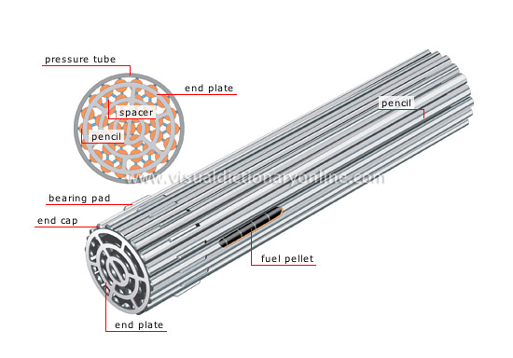
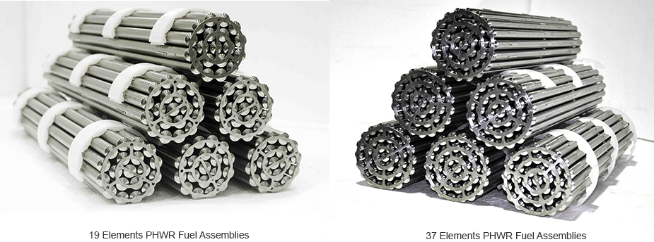
Fuel bundle products

Slide 16
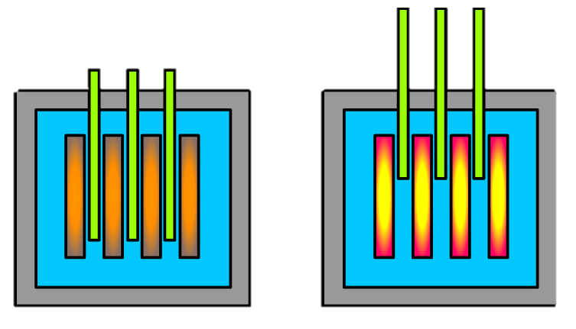
Control rods
A control rod is a device that is used to absorb neutrons so that the nuclear chain reaction taking place within the reactor core can be slowed down or stopped completely by inserting the rods further, or accelerated by removing them slightly. Essentially, control rods provide real-time control of the fission process, ensuring that it remains active while preventing it from accelerating out of control.
Uranium-235 fission releases 2.5 neutrons on average, but only one neutron is needed to sustain the nuclear chain reaction at a steady rate. The control rods absorb these extra neutrons and can be used to adjust the power output of the reactor. When inserted the standard amount, their position is at criticality and the power output remains the same. If the rod is pushed in the number of neutrons decreases along with the power output and the reactor is below criticality. The opposite is true if the rods are pulled out slightly as fission goes beyond criticality.
Fig. A schematic showing how reactor power output changes with how much the control rods (shown in green) are inserted. On the left, the control rods are inserted more than usual, reducing the power output of the reactor. On the right, the control rods are inserted less than usual, increasing the power output.

Slide 17
Conclusion

Slide 18
THANKYOU.

